Slide 1

BVICAM Semester Project and Review System
Under the guidance of:
Mr. Uttam Singh Bist
Assistant Pofessor, BVICAM
Mrs. Vaishali Joshi
Assistant Pofessor, BVICAM
By: Yash Raj (04835304418)
Hemant Kumar (01535304418)
MCA Batch 2018 – 2021

Slide 2
OUTLINE
Objective
Hardware and Software Requirements
Technology Used
Use Case Diagram
Data Flow Diagrams (DFD)
Entity Relationship Diagram
Database Diagram
Limitations
Future plans
References

Slide 3
Objectives
It is a user friendly project.
Student can upload their semester projects details and presentations.
Faculty can view and review the student projects and presentations.
Student can view the comments given by the faculty.

Slide 4
Hardware and Software Requirements
For Running
Google Chrome(preferred) or any other standard web browser.
For Development
1.6 GHz or faster processor
1 GB of RAM
20 GB of available hard disk space
5400 RPM hard disk drive
DirectX 9-capable video card (1024 x 768 or higher resolution)

Slide 5
Technology Used
For Development
ASP.NET 4.0, Css, Javascript, Ajax for Frontend
C# for Backend
SQL Server 2008 for Database

Slide 6
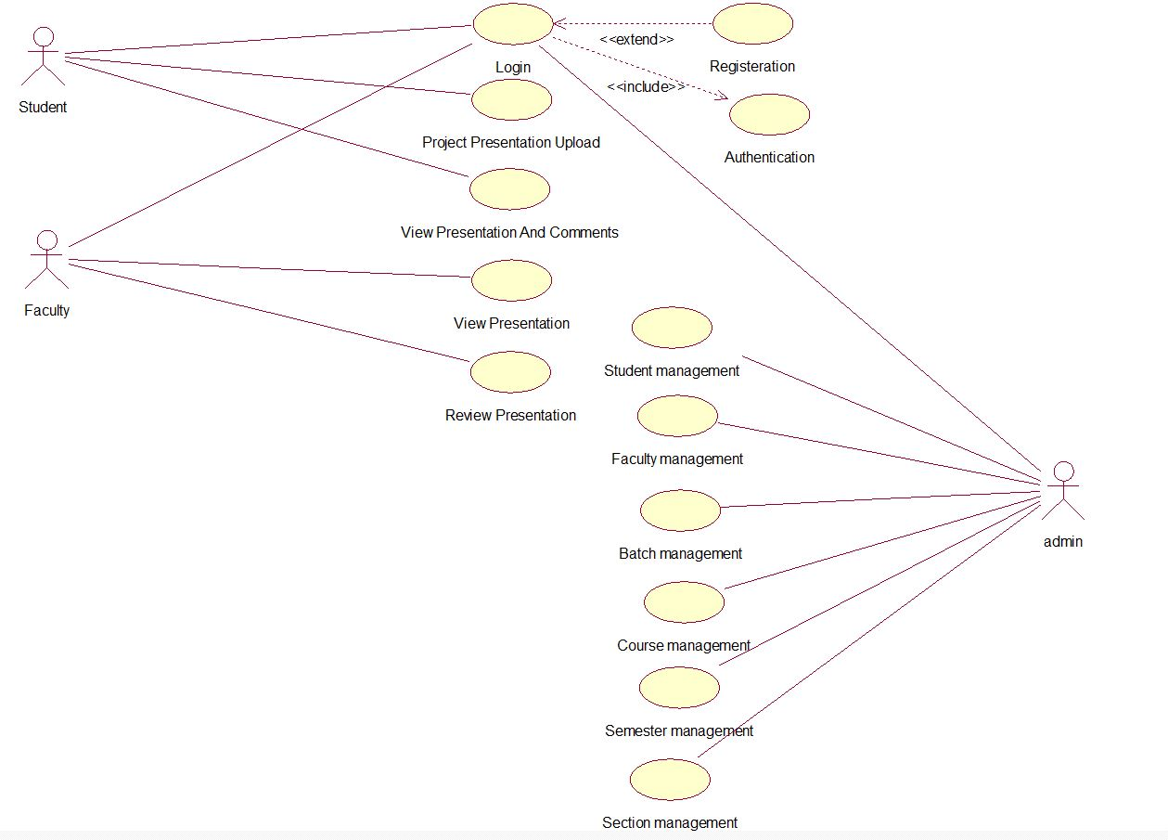
Use Case

Slide 7
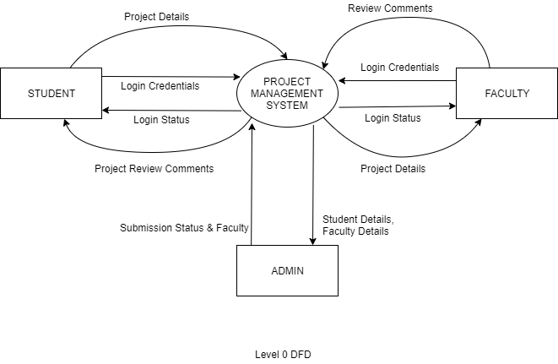
Data Flow Diagrams
LEVEL 0 :

Slide 8
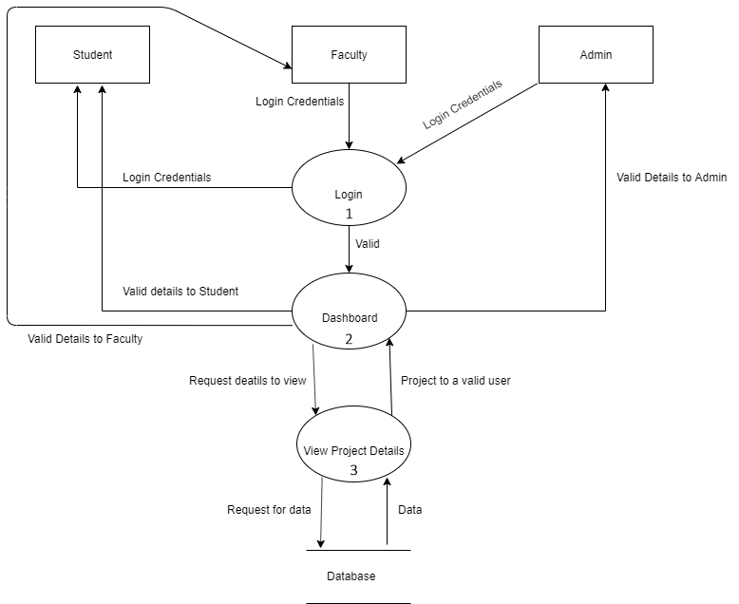
Data Flow Diagrams
LEVEL 1 :

Slide 9
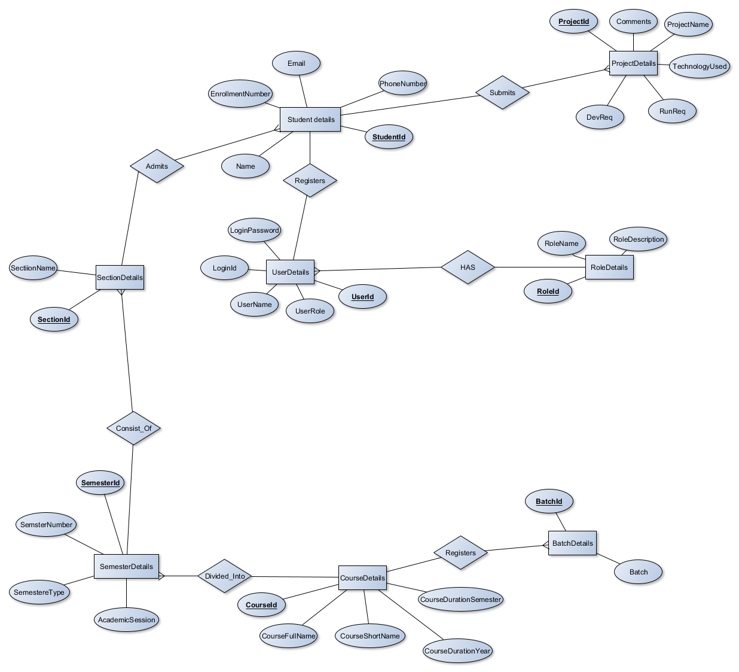
Entity Relationship Diagram

Slide 10
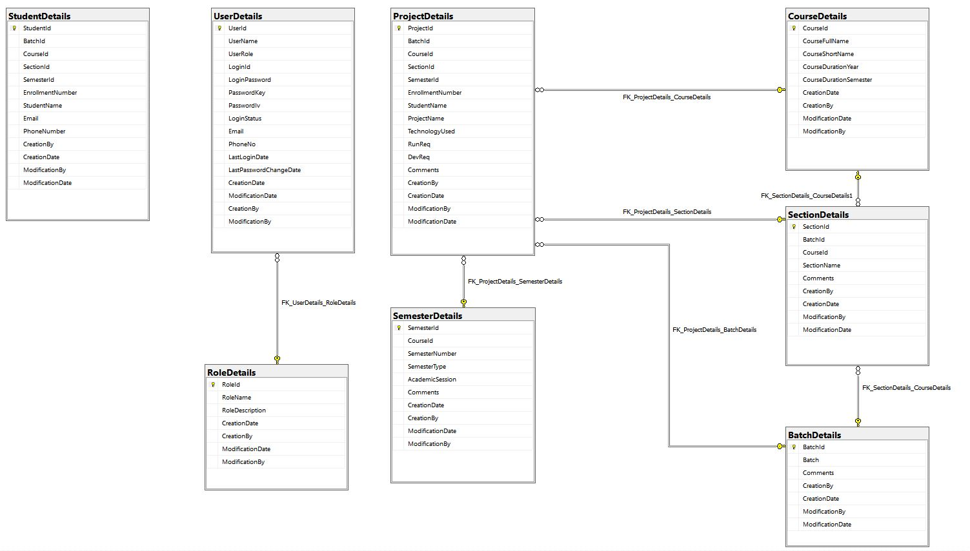
Database Diagram

Slide 11
Limitations
Project can not be revised by student once reviewed by the faculty.
Admin need to manually register each student and faculty.
Faculty can only review the project and cannot approve it.

Slide 12
Future Scope
Creating users using parsing a csv file.
Project revision module for student can be implemented.
Module for approval of project by the faculty can be implemented.

Slide 13
References
www.msdn.microsoft.com
www.google.com
www.c-sharpcorner.com
https://www.youtube.com/user/kudvenkat

Slide 14
Thank You

